Slide 1
Topic 3: Bailments
Lecture 1 – Introduction

Slide 2
Topic Contents
Why study bailments
Who’s who?
Nature and subject matter of bailments
Types of bailment
Liability for negligence and bailee’s duty of care
Bailor’s remedies in other torts
Orders of the court

Slide 3
Lecture 1 contents
Why study bailments?
Terminology
Nature of bailment
Species of bailment

Slide 4

Why study bailments?
They happen a lot
Major role in business
Carriage of goods
Sales awaiting collection
Pawnbrokers
Warehousing
Hire purchase

Slide 5

Terminology
Bailor = owner (usually) of goods subject to bailment
Bailee = one holding goods belonging to another
Goods subject to a bailment are said to be bailed by the bailor to the bailee

Slide 6
Nature of bailments
A separate obligation – alongside contracts, torts and quasi-contract/restitution
Can be created contractually, consensually, constructively or non-consensually
Duties can be contractually defined AND analogous to tort
Special rules apply as to burden of proof
Remedies can sound in contract or tort
Remedies can be damages or in rem

Slide 7

Subject matter – what can be bailed?
Only personal property
Only tangible property – no choses in action
But ‘valuable paper’ can be bailed
Compare with ‘goods’ in SGA 1979

Slide 8
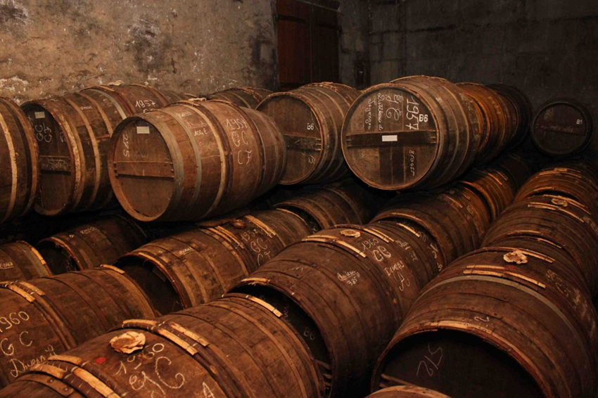
Species (types) of bailment: Coggs v. Bernard (1703)
Goods delivered to another to keep without fee. [Depositum]
Lending something for the use of the borrower, without charge. [Commodatum]
Hiring goods to another [Locatio et conductio]
Pledging goods (e.g., in a pawn shop) [Vadium]
Goods delivered to another to be carried for hire. [Locatio operis faciendi]
Goods delivered to another to be conveyed, or for a particular purpose without hire.” [Mandatum]

Slide 9
Since Coggs v. Bernard
Since Coggs v. Bernard was decided, we can add:
Locatio custodiae – what would otherwise be a depositum but for reward, i.e., where goods are bailed to someone who is paid to look after them, also known as “hire of custody”
Constructive bailments – including non-consensual bailments such as theft
Odd cases – e.g., conditional sales, railway tickets issued on condition of surrender at end of journey, etc.

Slide 10
Summary: types of bailment today
Depositum
Locatio custodiae
Commodatum
Locatio et conductio
Vadium
Locatio operis faciendi
Mandatum
Others…

